Slide 1


Impact of Science Conference the Roundtable on:
Addressing Local Community Challenges
25th June, 2021

Slide 2


Impact of Science
23-25 June, 2021
Trevor Stuthridge : Research Director of AgResearch, New Zealand
Garry Watson: Chairman of Nga Uri o te Ngahere Trust, and Founder / National coordinator of te Kohimarama, New Zealand
Overview of the Speakers
#IOS21

Slide 3
Impact of Science
23-25 June, 2021
Trevor Stuthridge
Research Director of AgResearch, New Zealand
Garry Watson
Chairman of Nga Uri o te Ngahere Trust, and Founder / National coordinator of te Kohimarama, New Zealand
#IOS21

Slide 4


Addressing local community challenges
Kohimarama: A unique flagship for indigenous community led research in Aotearoa New Zealand
Trevor Stuthridge Garry Watson
Research Director Chairman
AgResearch
āta mātai, mātai whetū
Nga Uri o te Ngahere Trust
Kaitiakai o te Ao Marama

Slide 5

1 Digital Agriculture
Turning data into knowledge into solutions
2 Ethical Agriculture
Doing the right thing the right way
3 Resilient Agriculture
Building the capacity to respond
4 Smart Foods
Tailoring what you eat to what you need
5 Beyond Food
No waste, new protein bio-economies
6 Consumer Interface
Best product, best market, best value
Te Ara Tika - embracing Mātauranga Māori as an equal knowledge system

Slide 6
1 Digital Agriculture
Turning data into knowledge into solutions
2 Ethical Agriculture
Doing the right thing the right way
3 Resilient Agriculture
Building the capacity to respond
4 Smart Foods
Tailoring what you eat to what you need
5 Beyond Food
No waste, new protein bio-economies
6 Consumer Interface
Best product, best market, best value
Te Ara Tika - embracing Mātauranga Māori as an equal knowledge system
  Unique Māori approach to our science
  Harness champions and early adopters
  Māori worldview through local partnerships
  For Māori specifically - for our sector generally

Slide 7
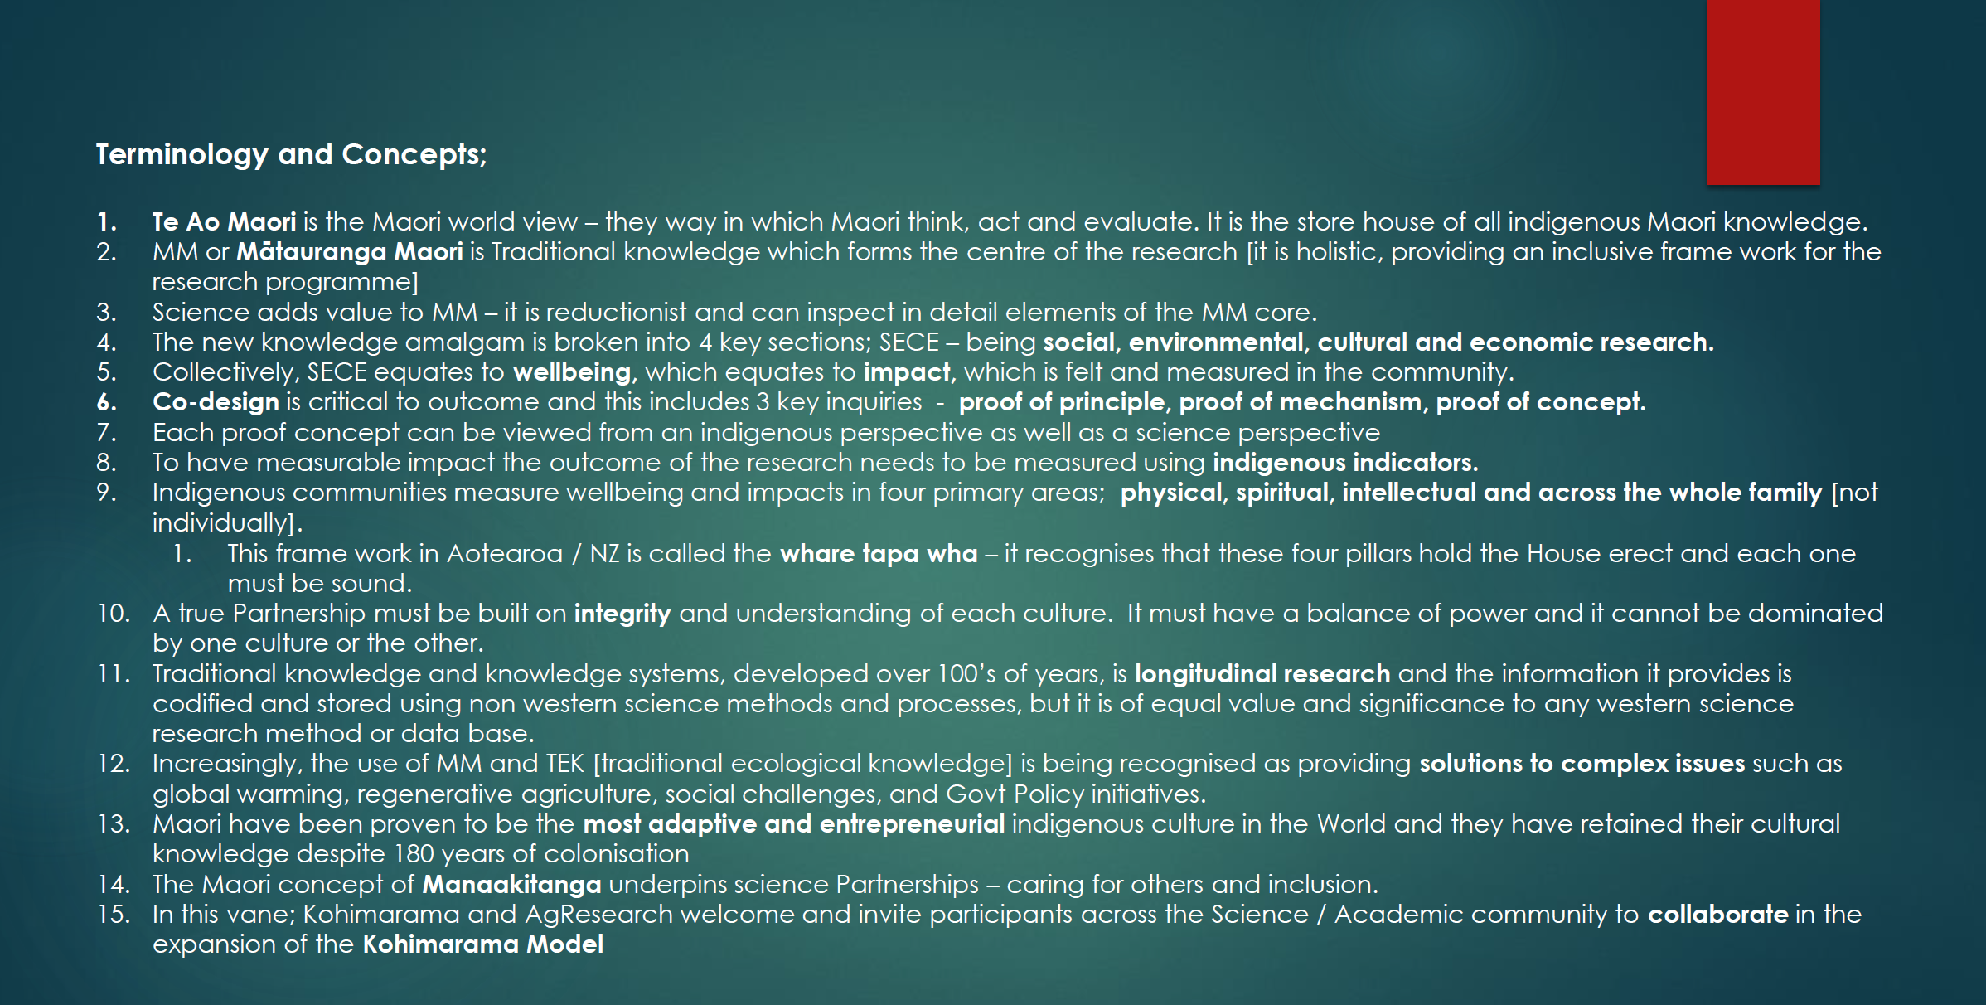

Slide 8
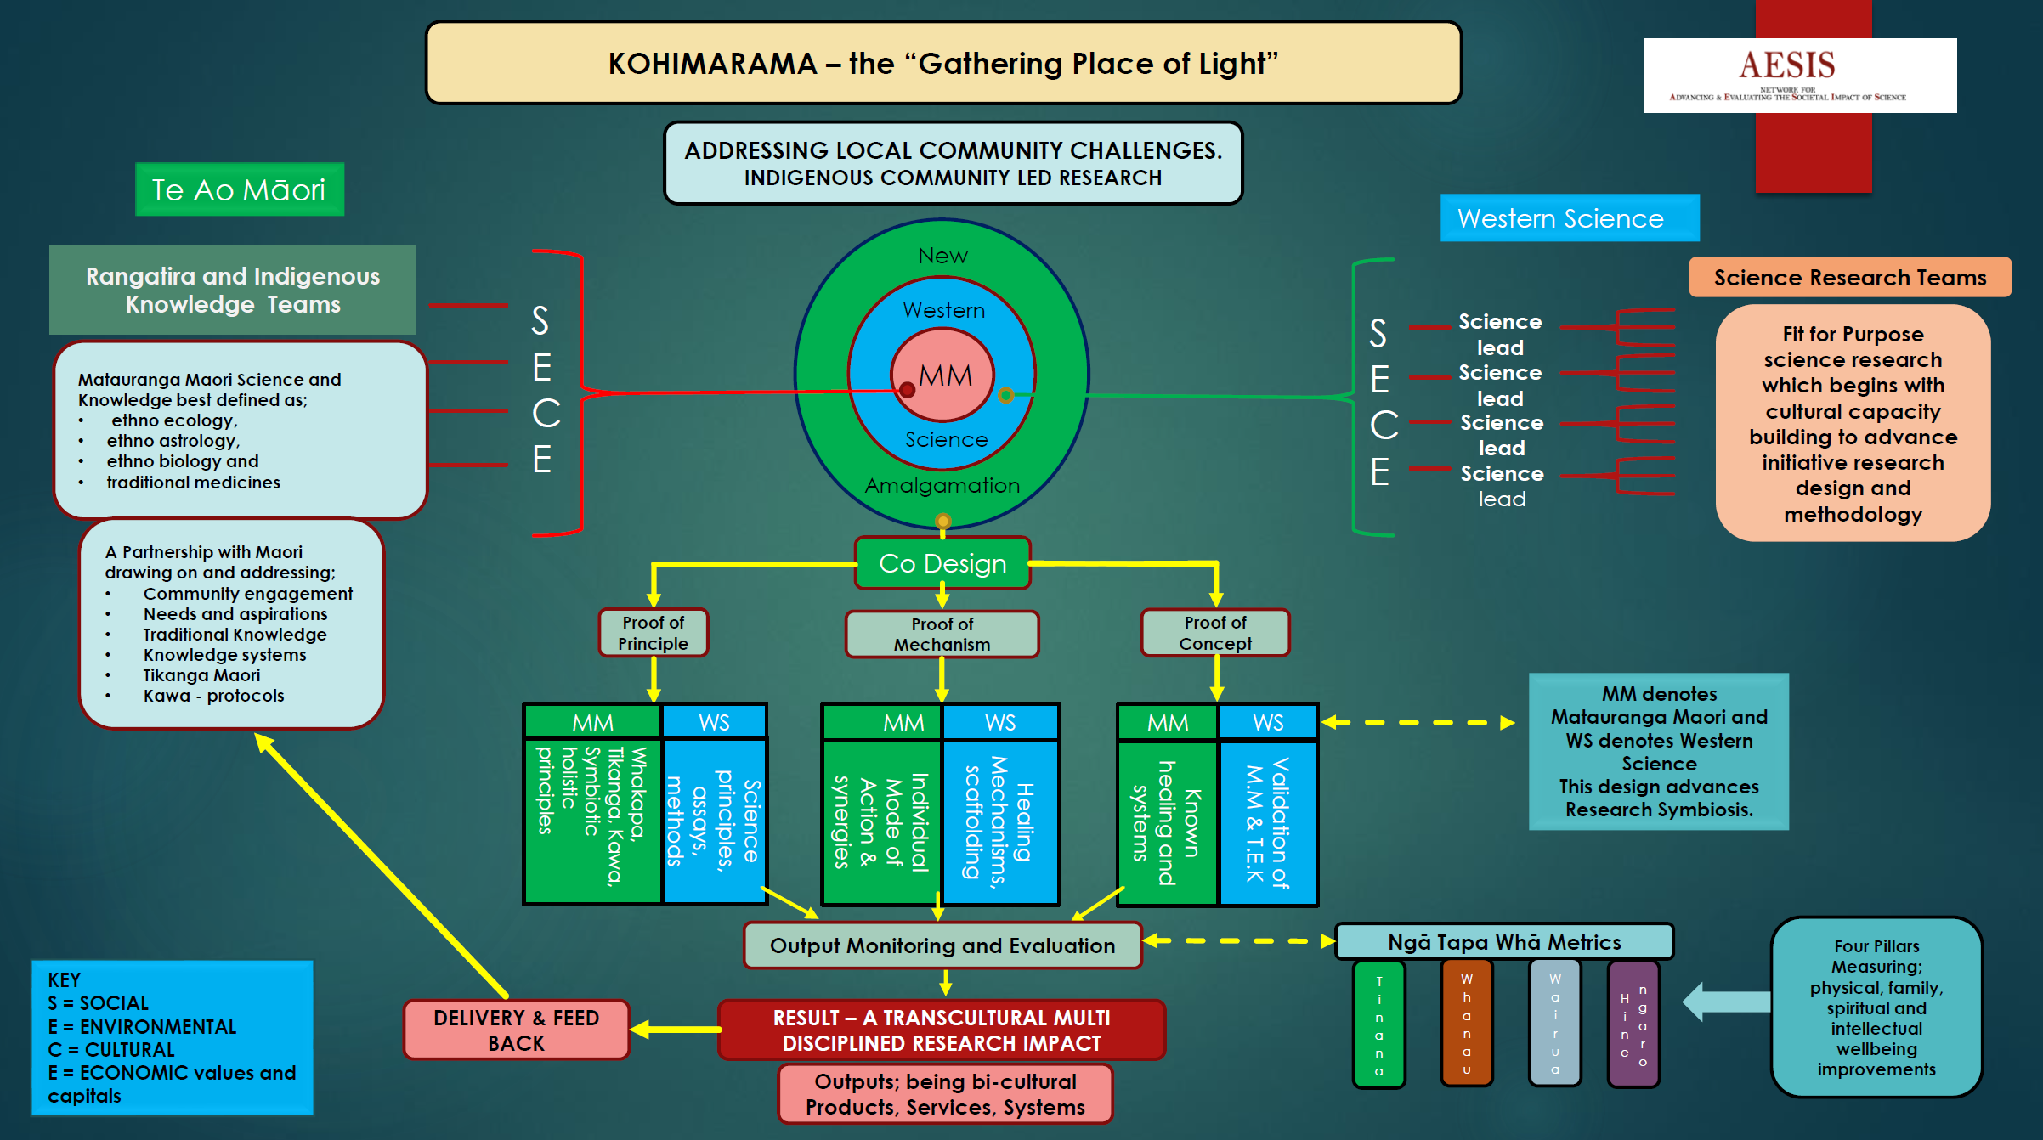

Slide 9
Kohimarama exemplars
CAPACITY BUILDING
NUOTN Te Ao Maori training
12 scientists over 2 years
Rangihaeata Rangatahi Succession plan
Science careers for rangatahi Maori

Slide 10
Kohimarama exemplars
INDIGENOUS ENTREPRENEURSHIP
First Light Foods
Wagyu beef production
Taonga Species and Rongoa Maori
Maori economic base through the use of our unique IP

Slide 11
Kohimarama exemplars
SUSTAINABLE LAND MANAGEMENT
Maramataka
Incorporating traditional Luna cycle knowledge into land utilisation models
Pakihiroa Farms
Land diversification across 50,000 ha of whenua Maori
Tino Rangatiratanga Endeavour
First contact land development and agricultural production

Slide 12
Kohimarama exemplars
SELF SUFFICIENCY
Torere Connect
Marae Provisioning Model
Micro Abattoir
Small processing units across East Cape region
Kai Kete
Supply chains for urban Maori provisioned from rural Maori production

Slide 13
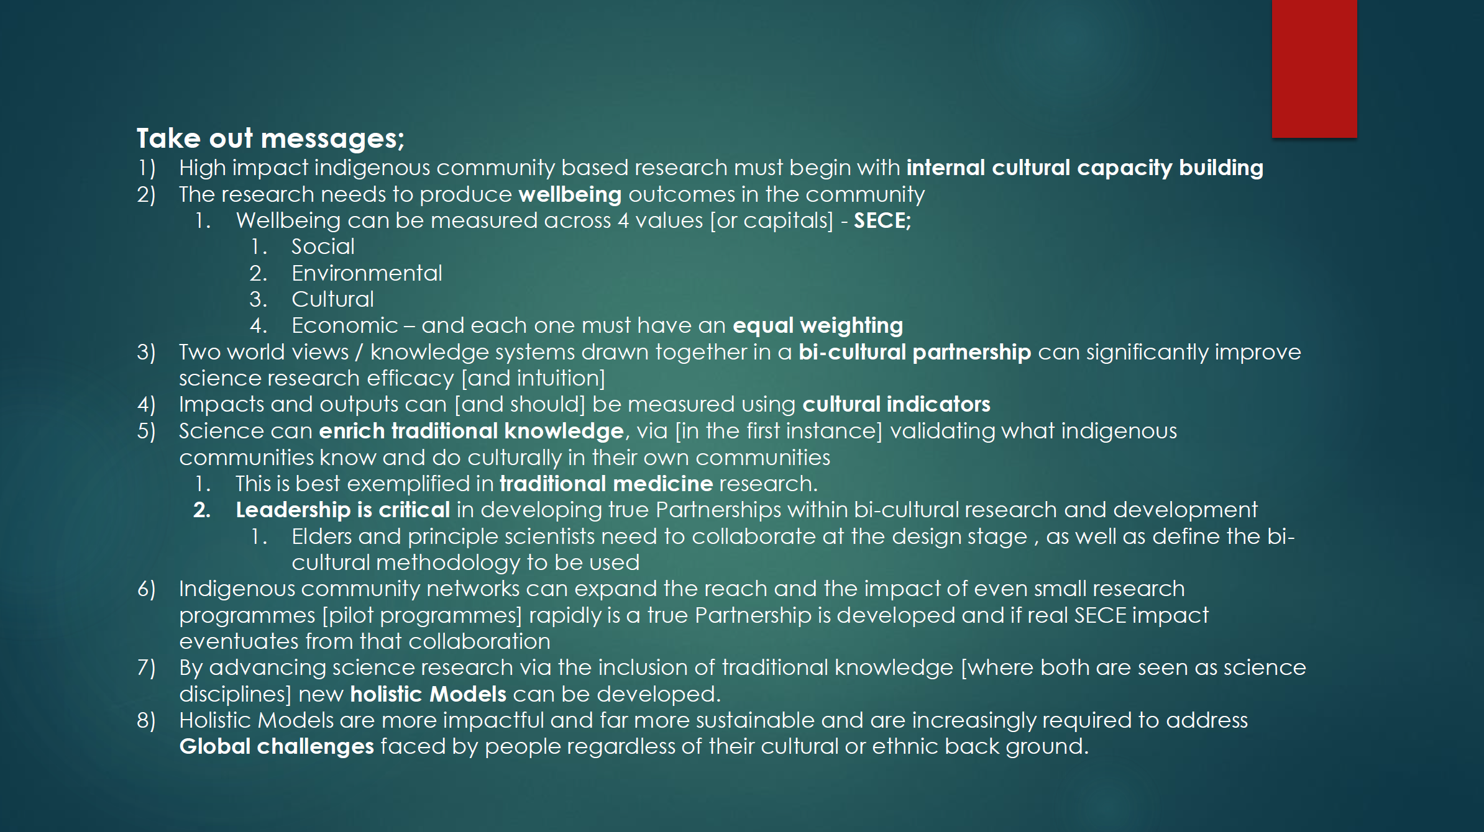

Slide 14
Impact of Science
23-25 June, 2021
Thank you
#IOS21

